Slide 1
Heart Disease Dataset FOR Analysis
MENU
ANALYSIS
CONTACT
Data ANALYSIS
Oral Defense

Slide 2
Heart Disease
MENU
ANALYSIS
CONTACT
Data ANALYSIS
Analysis by: Muhammad Hassan

Slide 3
TABLE OF CONTENT
iNTRODUCTION
Main explanations on project
01
02
Conclusion
03
MENU
ANALYSIS
CONTACT
Data ANALYSIS
A brief introduction about the dataset
Main explanations and the key findings will be described
Conclude the result based on our findings with recommendations

Slide 4
INTRODUCTION
MENU
ANALYSIS
CONTACT
Data ANALYSIS
01
The dataset has been taken from the kaggle and is related to the heart disease analysis of a patient. It is used to perform different analysis on the attributes of a patient.

Slide 5
Heart Disease Dataset
AIM
Size
Target
MENU
ANALYSIS
CONTACT
Data ANALYSIS
The aim of the dataset is to explore data in it to make recommendations for the patients which report different issues related to heart.
The dataset holds 1025 rows and 14 columns initially but the cleaning is performed on the dataset which makes the dataset concise.
Our goal attribute ‘target’ shows us the presence of heart disease in a patient. Value 0 indicates no heart disease and Value 1 indicates the heart disease.

Slide 6
Explanations on
Heart Dataset
02
MENU
ANALYSIS
CONTACT
Data ANALYSIS
Main
Data Exploring, Analysis, and Visualizations

Slide 7
Importing and cleaning the data
Import
Clean
MENU
ANALYSIS
CONTACT
Data ANALYSIS
The data has been imported successfully in pandas dataframe to perform analysis on it
And
The dataset contains the duplicates and we are not concerned about manipilating one record more than once. That’s why the dataset is cleaned and become concise

Slide 8
Data ANALYSIS
Type of attributes
Heart disease with age
Heart disease and diabetes
MENU
ANALYSIS
CONTACT
Data ANALYSIS
The attributes are all of numerical types which made the analysis more clear. None of the record is empty and they describe the different conditions of the patients.
Dataset reported different ages of patient. But heart disease is reported most of the times in the patients of age more than 50. It means the issues of a person with less does not mean heart disease.
Diabetes is not directly related with the heart disease. Mostly patients have heart disease but they are not suffering from diabetes.

Slide 9
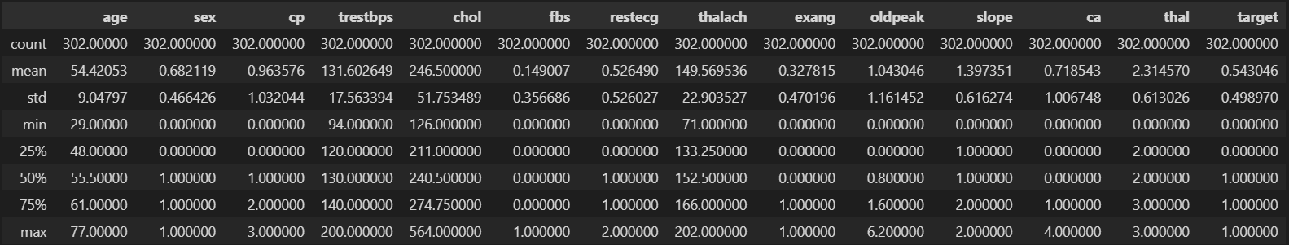
Attributes Detail
MENU
ANALYSIS
CONTACT
Data ANALYSIS
A table describing the attributes in a dataset:

Slide 10
Data ANALYSIS
Chest pain and thalassemia
Diabetes affecting cholesterol
MENU
ANALYSIS
CONTACT
Data ANALYSIS
The chest pain is normally reported when the patient’s thalassemia value is not normal. Patients having some problem in chest are usually dealing with abnormal thalassemia value when they report for heart disease.
Females usually feel more fluctuation in their cholesterol value when they have heart disease. But it does not make much effect in male’s body. They usually have less cholesterol value than females.

Slide 11

with some Visualizations
MENU
ANALYSIS
CONTACT
Data ANALYSIS
Analysis

Slide 12
Data Visualization
Males and females with heart disease
Chest pain type reported
Cholesterol values in different ages
MENU
ANALYSIS
CONTACT
Data ANALYSIS
The bar chart has been made which is showing the males and females with heart disease and without heart disease.
We see that the patients having a heart disease report different types of chest pains. The pie chart is displaying the ratio of each type of chest pain
Each patient has some cholesterol value. The scatter plot is made to represent the value of cholesterol. There is also a horizontal line in figure to display the average cholesterol value.

Slide 13
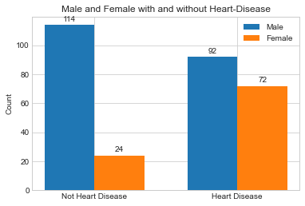
BAR graph for heart Disease
MENU
ANALYSIS
CONTACT
Data ANALYSIS
68%
Males
The dataset mostly contains the male. The males with heart disease are more than femeales
32%
Females
Females are less in dataset. But the most of them have heart disease

Slide 14
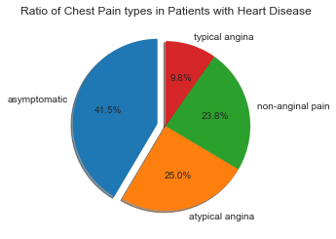
Do we have a specific pain type?
MENU
ANALYSIS
CONTACT
Data ANALYSIS
41.5%
9.8%
Most of the patients have asymptomatic chest pain
The least type of chest pain reported is typical angina
25.0%
23.8%
Atypical anginal pain is reported in one fourth patients during analysis
Some patients felt non-anginal chest pain which is shown in a chart

Slide 15
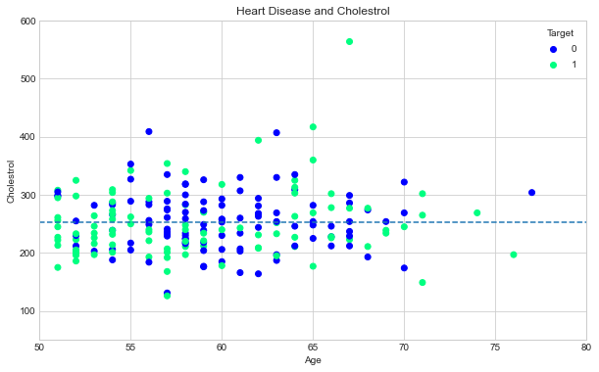
Cholesterol value with age
MENU
ANALYSIS
CONTACT
Data ANALYSIS
Cholesterol values vary from person to person because:
It depends on the body type
It depends on the age
It can affect depending on the condition of disease in a body
The average cholesterol in the dataset is between 200 and 300. This range contains patients both with and without heart disease

Slide 16
Conclusion
03
MENU
ANALYSIS
CONTACT
Data ANALYSIS
Putting it all together

Slide 17
Conclution
MENU
ANALYSIS
CONTACT
Data ANALYSIS
From our discussion we have seen that:
Heart disease in a patients of age less than 50 is less.
Probability of heart disease in male is more than in females.
Before the age of 30, there is an exceptional case that the person would have heart disease.
if a person has any chest pain, they will also have some problem with thalassemia value.
The male's cholesterol usually doesn't fluctuate much with diabetes.
We can also recommend that if a person has heart disease, there is less chance that they would have diabetes as well.

Slide 18
Conclution
MENU
ANALYSIS
CONTACT
Data ANALYSIS
Data analysis helps us in exploring the data and make useful decisions.
Data can be analyzed with different perspectives to provide accurate result.
Pandas has strong grip in manipulating the datasets in different formats e.g., csv, excel, etc.
Visualizations help us understand the information in easier and better way.

Slide 19
CONTACT US!
Muhammad Hassan
Linkedin profile
EMAIL
MENU
ANALYSIS
CONTACT
Data ANALYSIS
https://github.com/developer-hassan
https://www.linkedin.com/in/muhammad-hassan-a7774b221/
hassanasim5567@gmail.com

Slide 20
THANKS!
MENU
ANALYSIS
CONTACT
Data ANALYSIS
Do you have any questions?

